Slide 1
Data Visualization: An Introduction
Harriett Green
University of Illinois at Urbana-Champaign
Data Driven Scholarship Autumn Institute
University of Hong Kong, November 28-30, 2016
green19@illinois.edu | @greenharr

Slide 2
Thank you to: Ruohua Han, graduate assistant, School of Information Sciences

Slide 3
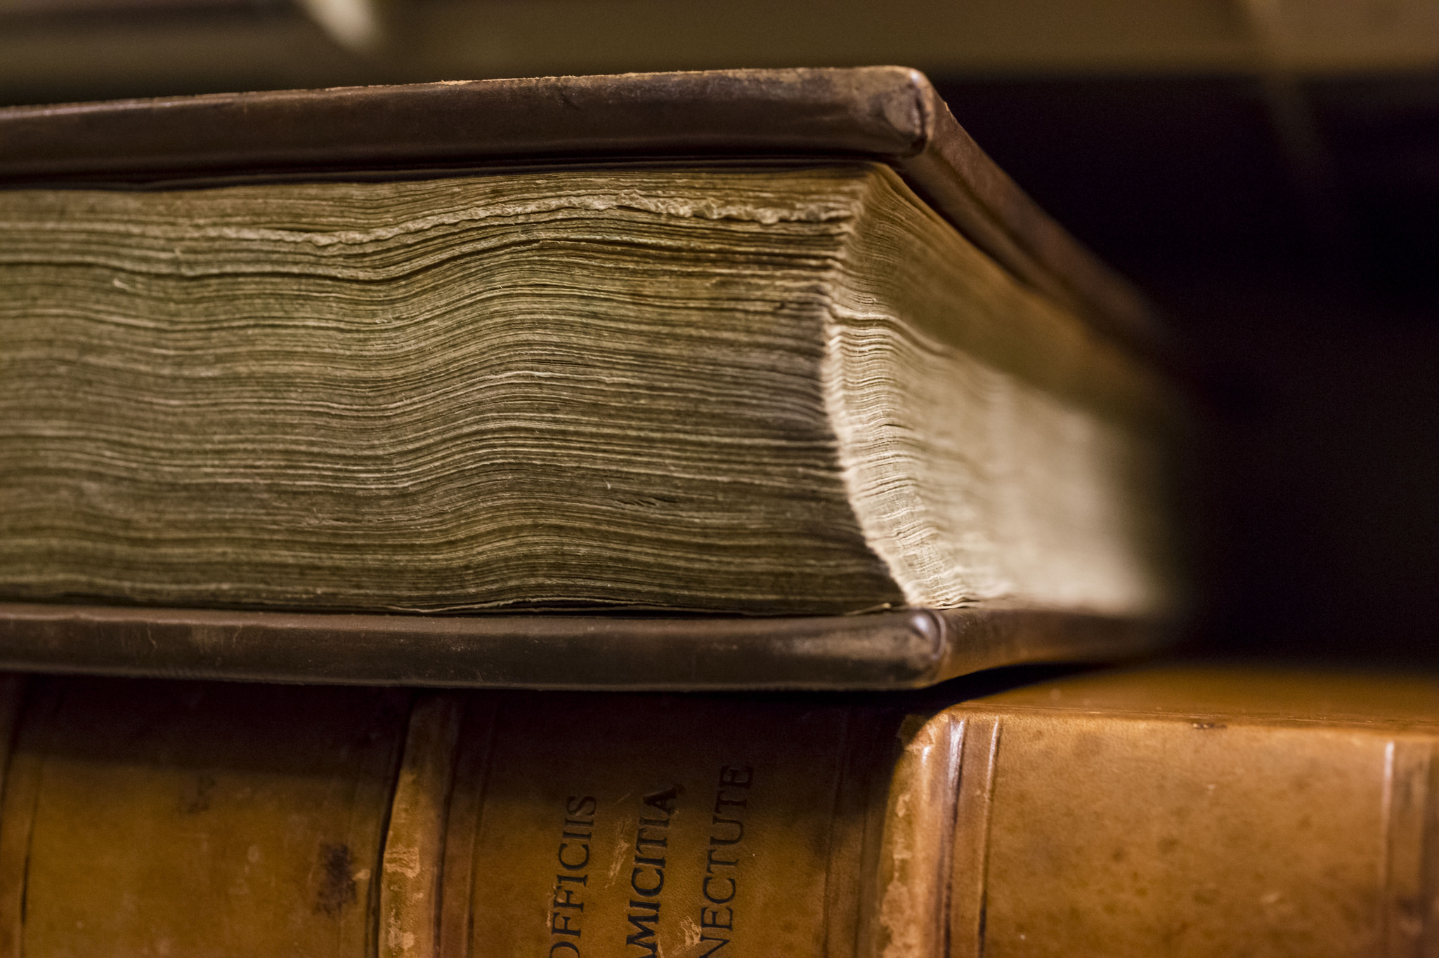
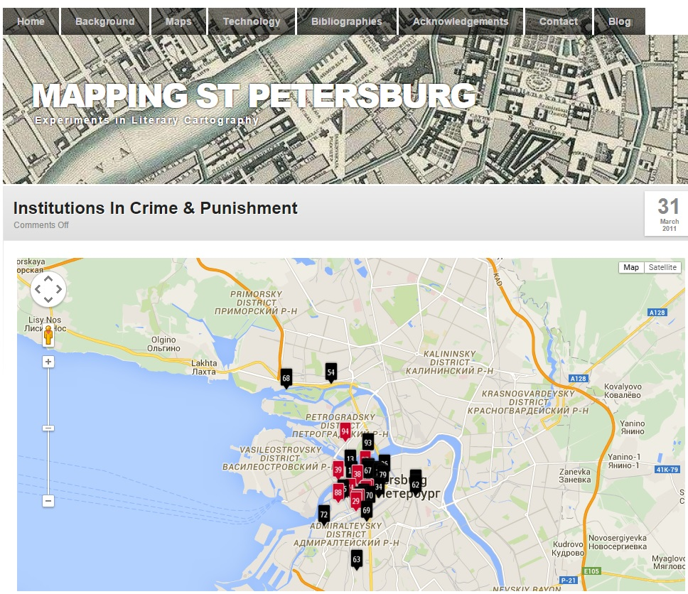
How Do Scholars Communicate Their Research Today?
Mapping St. Petersburg, http://www.mappingpetersburg.org/site/?page_id=120
Rare Book and Manuscript Library, University of Illinois Library, L. Brian Stauffer
Notes:
Scholars have long disseminated their work via books and printed materials, but with the advent of digital content and data

Slide 4
Scholarly Communications are transforming…
“Many meaningful outcomes of computationally intensive research, such as data-rich visualizations, cannot be distilled into conference presentations, journal articles, or monographs. Taking advantage of current web technologies, leaders in the academic sector can create new models for publication that incorporate rigorous review processes while at the same time inviting diverse data-rich and multimedia contributions to the academic record.”
Williford, Henry, and Friedlander, One Culture: Computationally Intensive Research in the Humanities and Social Sciences, A Report on the Experience of the first Respondents to the Digging into Data Challenge
Notes:
One good description of this data-driven shift in scholarly practices, is captured in this quote from a relatively recent CLIR report on the Digging Into Data initiative, a multi-national grant program to encourage multi-disciplinary collaborations around big data.
As this quote from the report notes, Research strategies in the humanities and social sciences have changed in critical ways with the advent of digital tools and new types of collaborations.
Thus we must learn and determine how to work with the multitude of data-driven methods and modes that scholars are increasingly using and applying in their research and scholarly communications.

Slide 5
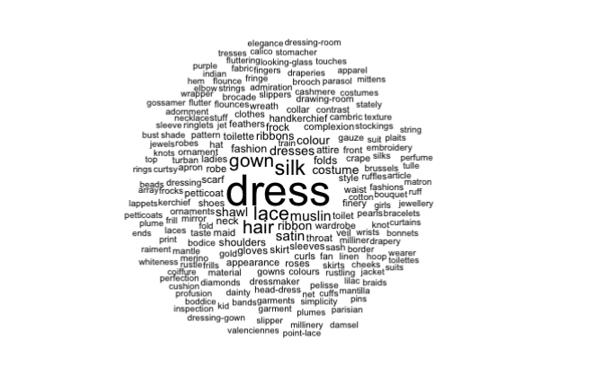
What Is Data Visualization?
The process of converting data sources into a visual representation
A visual representation of data sources
Use software such as:
R Studio
Gephi
NodeXL
ORA
Mathematica
Figure from “Significant Themes in 19th Century
Literature,” Matt Jockers & David Mimno, Poetics, December 2013

Slide 6
Why Visualize Data?
To understand the broader themes of a dataset
Explore patterns in the data
To cluster texts for overview or classification
To compare collections of data,
Understand the evolution of a dataset over time and space
To compare patterns in text to those in other data (e.g., correlating with social networks).
Notes:
Can serve as a useful discovery tool and create new knowledge.
Visualizations can be very helpful in understanding and exploring large datasets. You may discover things that formal statistical methods cannot reveal. It helps with looking at more than individual values, but also patterns, properties and relationships, making it easier to compare and contrast, as well as track changes in time/space. (Yau, xvi)
Why visualize text in the discovery process specifically? (Adapted from Stanford course slides, see item in further reading section)
To understand the general “gist” of a text, and to explore patterns in a text.
To cluster texts for overview or classification.
To compare collections of text, or to understand the evolution of one collection over time.
To compare patterns in text to those in other data, for example correlating with social networks.
Can serve as an efficient way of communication.

Slide 7
When Is Data Visualization Used?
Exploration
Explore the full range of the data
Discover characteristics and themes in the data
Explanation
Communicate your findings to others
Present your results in a publication

Slide 8
Approaches to Data Visualization
Types and Formats

Slide 9
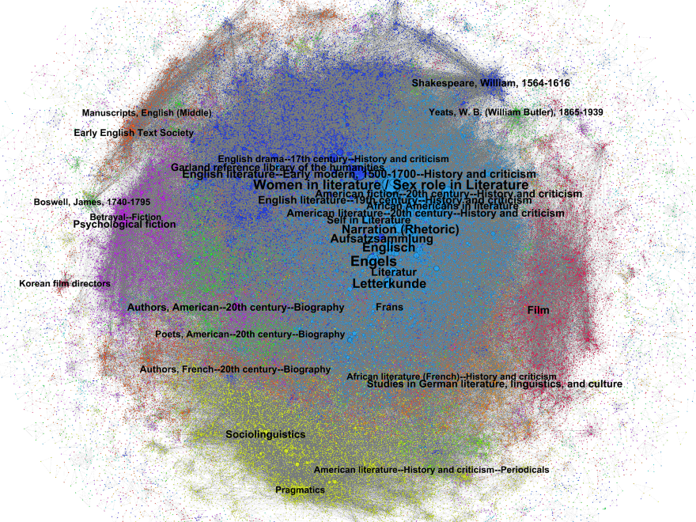

Network Analysis
Gephi
NodeXL
Plot.ly
Google Fusion Tables
d3
Harriett Green and Kirk Hess, “Clusters of Books: Subject Analysis Tools for the Library Catalog,” ACRL 2013 presentation

Slide 10
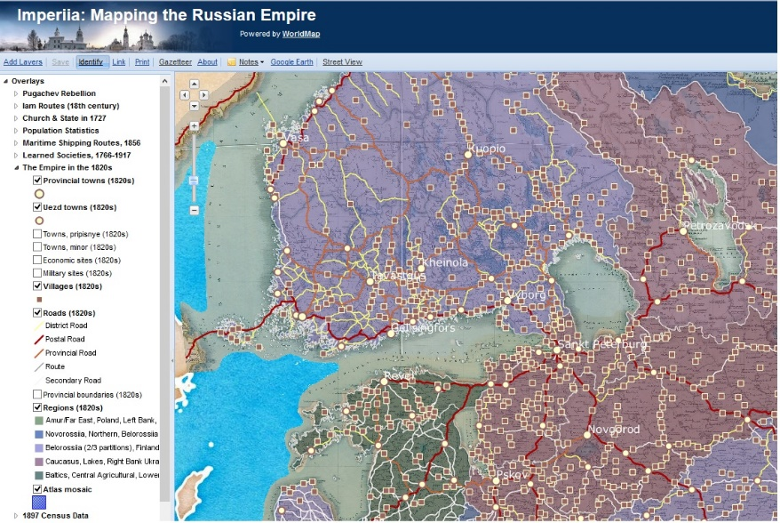
Maps and Geographic Information Systems
ArcGIS
ArcGIS Online/StoryMaps
World Mapper
Quantum GIS
Google Earth
Historical map archives (e.g., David Rumsey Map Collection)
Prof. Kelly O’Neill, Imperiia Project, http://worldmap.harvard.edu/maps/886

Slide 11
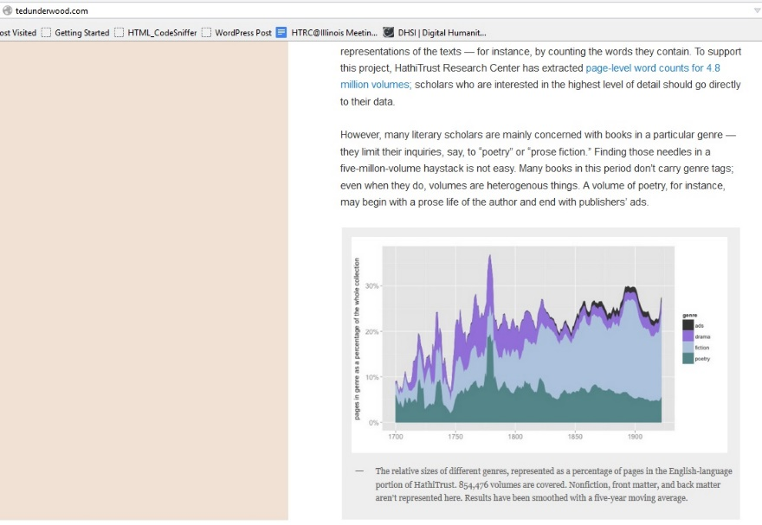
Data mining and stat analysis
MS Excel/Spreadsheets
R Studio
Python
Mathematica
D3.js
MySQL and PHP
OpenRefine
Ted Underwood, “A dataset for distant-reading literature in English, 1700-1922.” “http://tedunderwood.com/2015/08/07/a-dataset-for-distant-reading-literature-in-english-1700-1922/

Slide 12
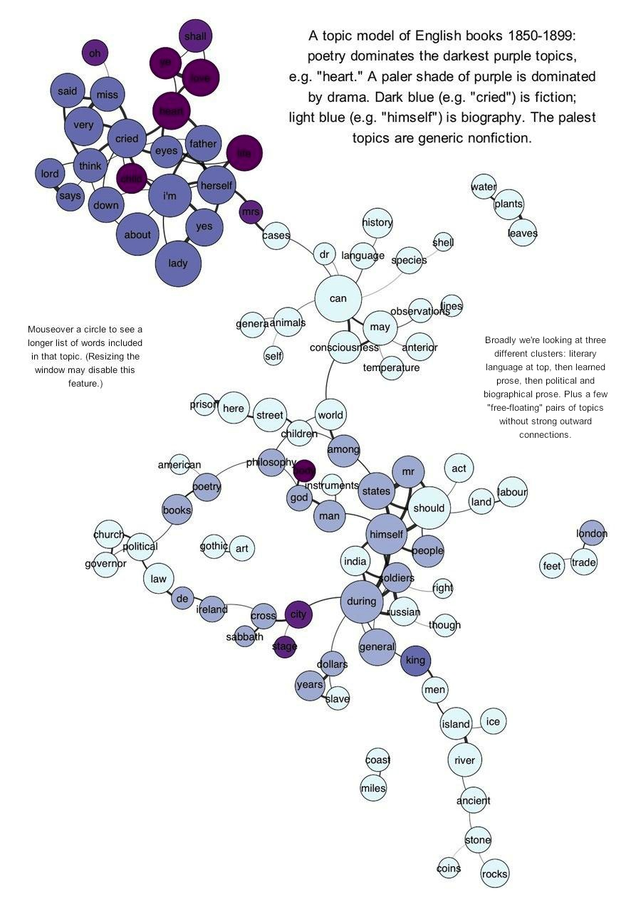
Example 1: Topic Modeling
Topic model of English books, 1850-1899
Read more by Ted Underwood, “Visualizing Topic Models,” https://tedunderwood.com/2012/11/11/visualizing-topic-models/
Source: http://post1850map.site44.com

Slide 13
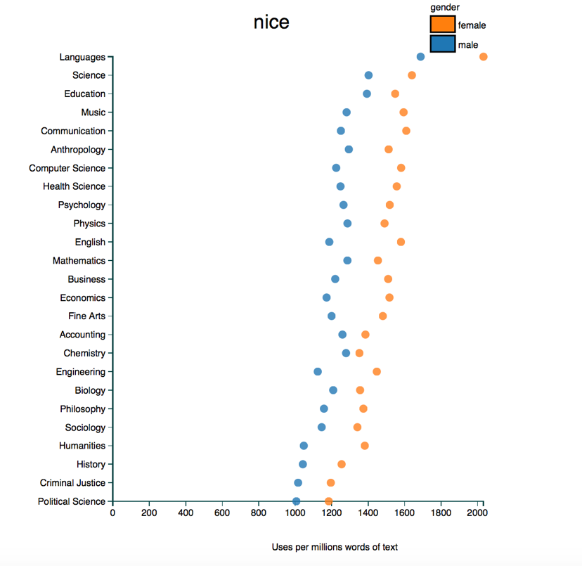
Example 2: Types of Languages
Ben Schmidt created an interactive chart that enables users to explore the words used to describe male and female teachers in about 14 million reviews from RateMyProfessor.com.
Ben Schmidt, “Gendered Language in Teaching Evaluations, http://benschmidt.org/profGender/#
Notes:
This is an interactive chart that enables users to explore the words used to describe male and female teachers in about 14 million reviews from RateMyProfessor.com.
Ben Schmidt, a professor at Northeastern University, did an analysis of reviews submitted to this website by students of their faculty and instructors: He found distinctly types of descriptions and language based on the teacher’s gender as male or female. This particular visualization shows use of the word “nice” in reviews – it was used far more often for women than men, especially in Engineering, English, and general Humainties.

Slide 14
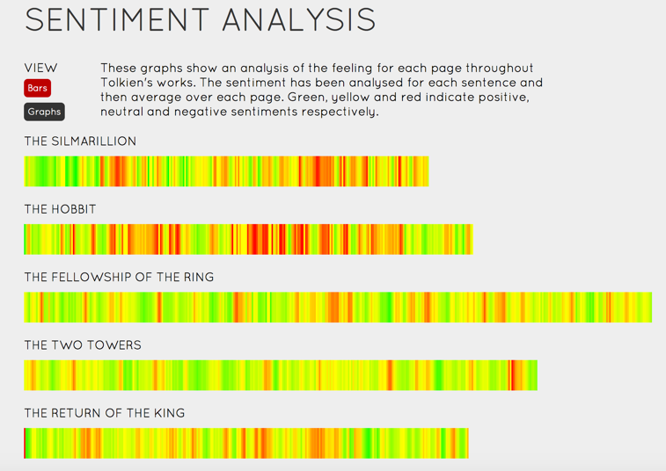
Example 3: Works of an Author
Sentiment Analysis of J.R.R. Tolkien’s works
Lord of the Rings Online: http://lotrproject.com/statistics/books/
Notes:
This particular visualization displays the results of sentiment analysis conducted on Tolkien’s works – they analyzed what the general sentiment or nature of the texts as leaning positive or negative, and the indicators are based on the color (Green for positive to red for negative)
This site has a variety of visualizations of various aspects of the works by J.R.R. Tolkien, including maps, timelines, and statistics.

Slide 15
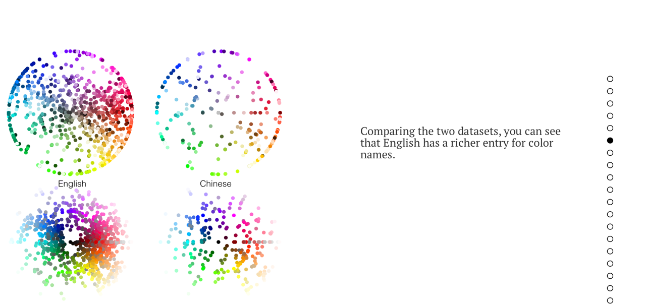
Example 4: Visualizing Languages
How color is described in English vs. Chinese
http://muyueh.com/greenhoney/
Notes:
This chart isn’t exactly a data visualization per say, but shows linguistic diversity between langugages: ON the right is the number of phrases in English for color, compared to Chinese.

Slide 16
Types of Data in Visualizations
1 – dimensional data:
Texts
Tables
Source Code
Word clouds
2 –dimensional data
Spatial data
Maps
Cartograms
3 – dimensional data:
Real world objects with volume and textures
3D models
3-D simulations
Temporal Data
Have a start and finish
Timelines
Spiral Plots

Slide 17
Types of Data and Visualizations, cont.
Multi-dimensional data:
Have multiple variables
Pie charts
Bar charts
Tree Data
Data with hierarchies and tree structures
Tree Maps
Radial Trees
Network data
Data with web-like relationships that cannot be captured in a tree structure
Network graph
Matrix
Alluvial diagram
Node-link diagram

Slide 18
Display Functions of Data Visualizations
Comparison
Bar charts
Area charts
Line charts
Distribution
Scatter charts
Bubble charts
Composition
Pie charts
Doughnut charts
Relationships
Venn Diagrams
Network graphs
For more information, see The Data Visualization Catalogue by Severino Ribecca
http://www.datavizcatalogue.com/index.html

Slide 19

How to Visualize Data: A Walk Through

Slide 20
How To Visualize Your Research
Acquire Data
Format Data
Analyze and Visualize

Slide 21
Step 1: Obtain Data
What kind of data can you use in data visualizations?
Text files: .TXT, .XML, .XSLT
Numeric data
Code
Geographic data
Social media data
Multi-variable datasets

Slide 22








Where do you get data?
And many more….

Slide 23
How do you get the data?
Bulk downloads
Web Scraping
Application Programming Interface (API)
FTP and Rsync
Negotiate with the provider

Slide 24
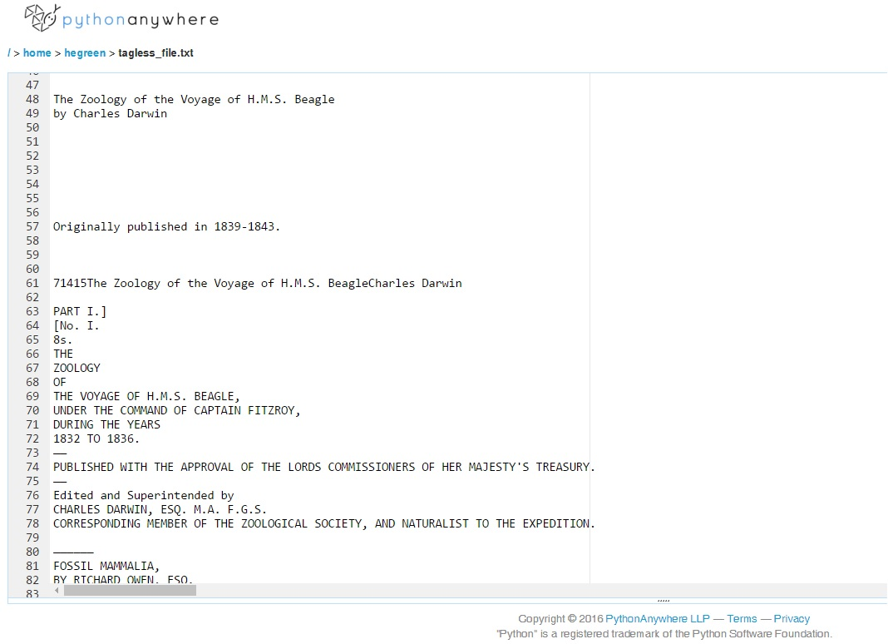
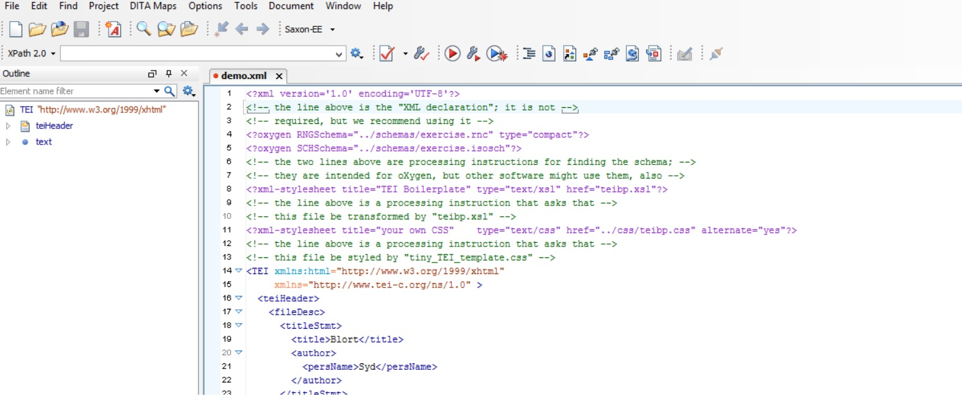
STEP 2: Data cleaning and formatting
How do you get data from this…
To This?

Slide 25


Resources for Data Formatting
Open Refine
Excel/spreadsheet software
MySQL
Python
Data Carpentry lesson: http://www.datacarpentry.org/spreadsheet-ecology-lesson/01-format-data.html

Slide 26
STEP 3: Identify Type of Visualization
What Type(s) of Data Do I Have?
What Kinds of Analysis Did I Do / Want to Do?
How Do I Want to Communicate My Results?

Slide 27

Examples: How They Did It

Slide 28
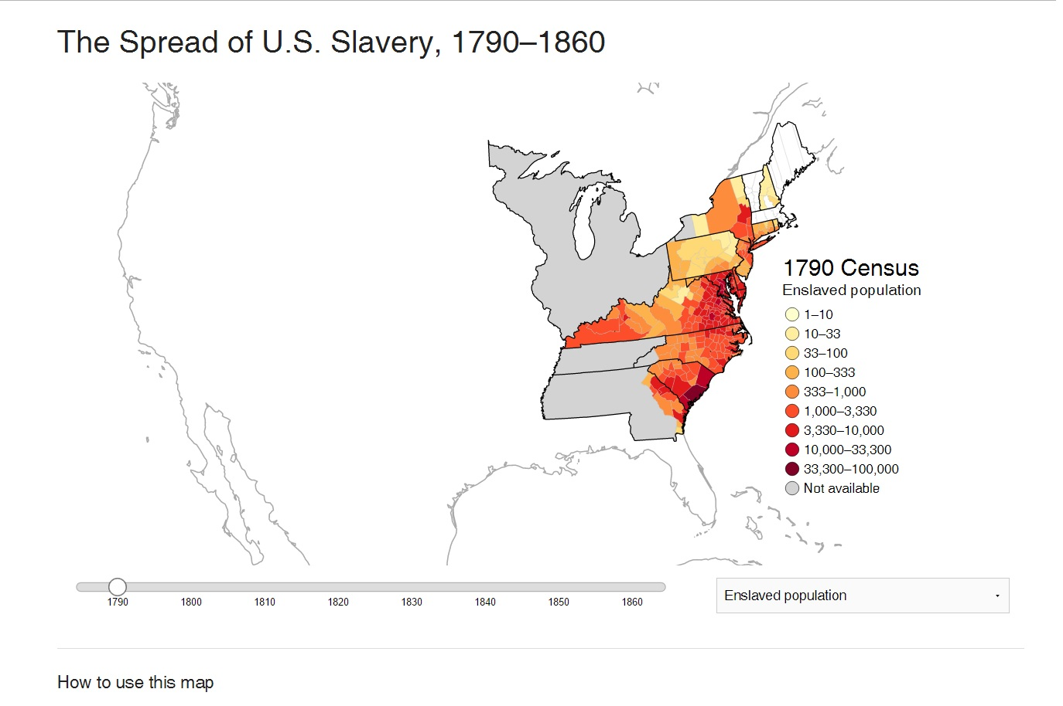
Example 1: Lincoln Mullen
Lincoln Mullen, “Mapping the Spread of American Slavery, 1790-1860”
Published in Smithsonian Magazine: http://www.smithsonianmag.com/history/maps-reveal-slavery-expanded-across-united-states-180951452/
http://lincolnmullen.com/projects/slavery/

Slide 29
How It Happened….
Project overview: http://lincolnmullen.com/blog/mapping-the-spread-of-american-slavery/
Used historical census and geographic data from:
National Historic Geographic Information System, https://www.nhgis.org/ , https://www.nhgis.org/user-resources/datasets-overview
Code: https://github.com/lmullen/slavery-map
Lincoln Mullen, "The Spread of U.S. Slavery, 1790–1860," interactive map, http://lincolnmullen.com/projects/slavery/, doi: 10.5281/zenodo.9825.

Slide 30

Example 2: Visualizing Library Collections
Collaboration with Library colleague and Economics PhD student
Applied and awarded a XSEDE Start Up Allocation of 30,000 SUs
Worked on the Nautilus supercomputing cluster at Oak Ridge National Laboratory, University of Tennessee

Slide 31
searches in OPAC != effective browsing
Items are buried in the online catalog
Research Questions:
How do we expose the underused (“understudied”) materials in the Library collection?
How do we facilitate serendipitous browsing in the online environment?

Slide 32
research
Test set: Literatures and Languages Library collection of ~40,000 items
Eventually did the full collection of over 1 million items
Used R for computational algorithms
Use supercomputing resources to generate predictive network analyses
Visualizations generated using Gephi

Slide 33
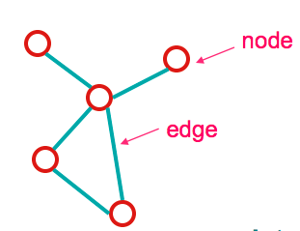
social network analysis: terms
Network: sets of nodes connected by edges
Network ≡ Graph
Nodes (a.k.a. vertices)
Subject headings = nodes
Edges: connections between nodes

Slide 34
terms (cont.)
Centrality: Which nodes are important in the network?
Betweeness Centrality - number of shortest paths that pass through a node.
Modularity: edges that fall in a particular group vs. a random distribution.
A method for detecting communities or clusters of related nodes.

Slide 35
subject headings clusters
Nodes: All headings of items held in Literatures and Languages Library.
110617 headings
675302 item connections
Edge Weight by # of MFHDs
Colors = community detection
Research question: How to find items that are most relevant to each other?

Slide 36
top 10 LCSH by betweenness centrality
Name | Betweenness
Women in literature | 231643799
Narration (Rhetoric) | 174533800
Sex role in Literature | 145344899
English literature--Early modern, 1500-1700--History and criticism | 119439534
Film | 98546684
English literature--19th century--History and criticism | 90429676
American fiction--20th century--History and criticism | 84344961
Self in Literature | 83412681
American literature--20th century--History and criticism | 78992556
Sociolinguistics | 73889793
African Americans in literature | 73436225
Top 10 LCSH by
Betweenness Centrality
Name | Betweenness
Women in literature | 231643799
Narration (Rhetoric) | 174533800
Sex role in Literature | 145344899
English literature--Early modern, 1500-1700--History and criticism | 119439534
Film | 98546684
English literature--19th century--History and criticism | 90429676
American fiction--20th century--History and criticism | 84344961
Self in Literature | 83412681
American literature--20th century--History and criticism | 78992556
Sociolinguistics | 73889793
African Americans in literature | 73436225

Slide 37
method
Export data from OPAC into tsv files
Transfer data to XSEDE - Nautilus
Import data from tsv into R
Manipulate data frame with iGraph
Export iGraph object to graphml
Import graphml into Gephi
Calculate betweeness, closeness, eccentricity, modularity in Gephi
OpenOrd layout
Export image

Slide 38


Slide 39
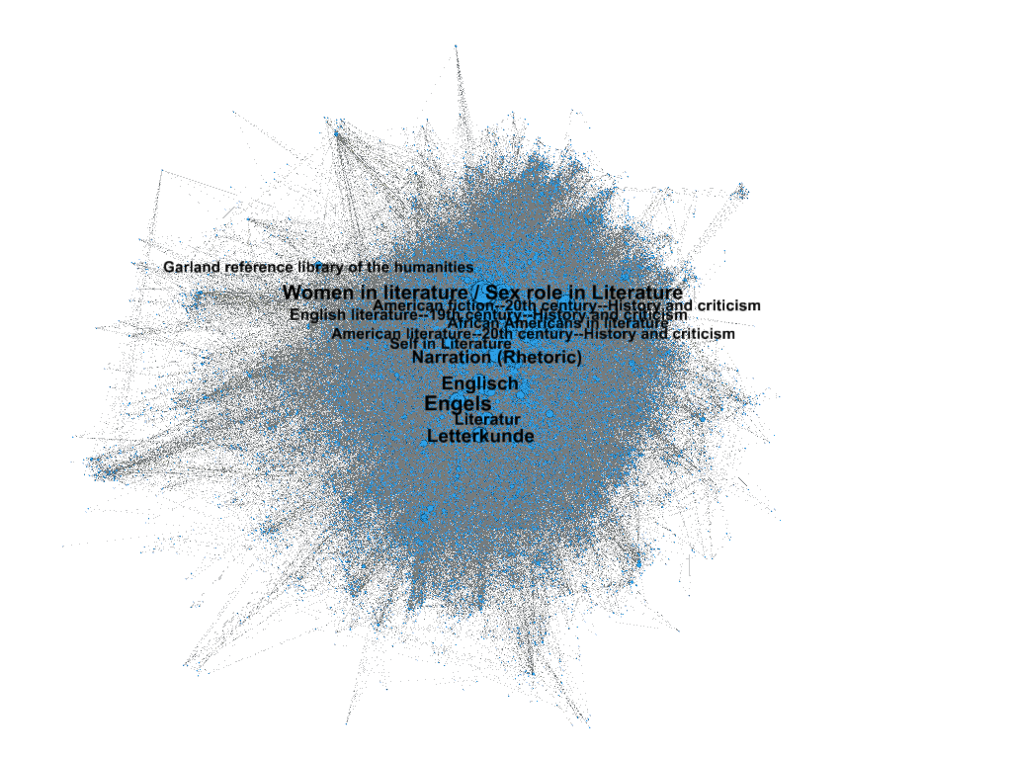
Clusters
Communities or Modules
Largest cluster 1393: ‘English Literature’
28.23% nodes
35.86% edges
Sigma.js demo

Slide 40
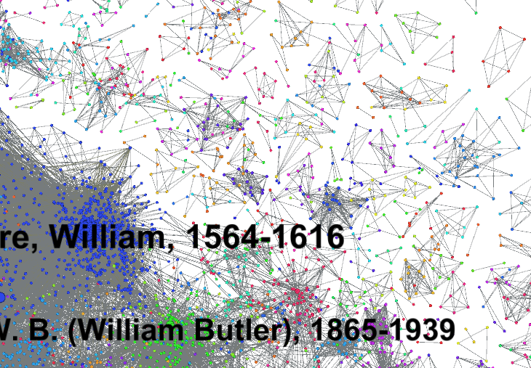
Isolated Component

Slide 41
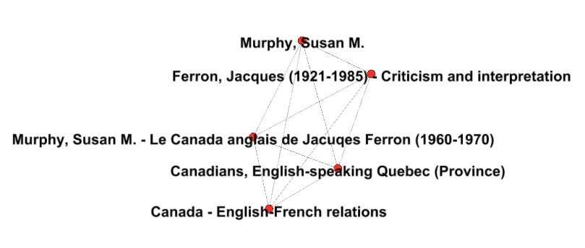
Isolated Component
http://vufind.carli.illinois.edu/vf-uiu/Record/uiu_6821115/Details

Slide 42
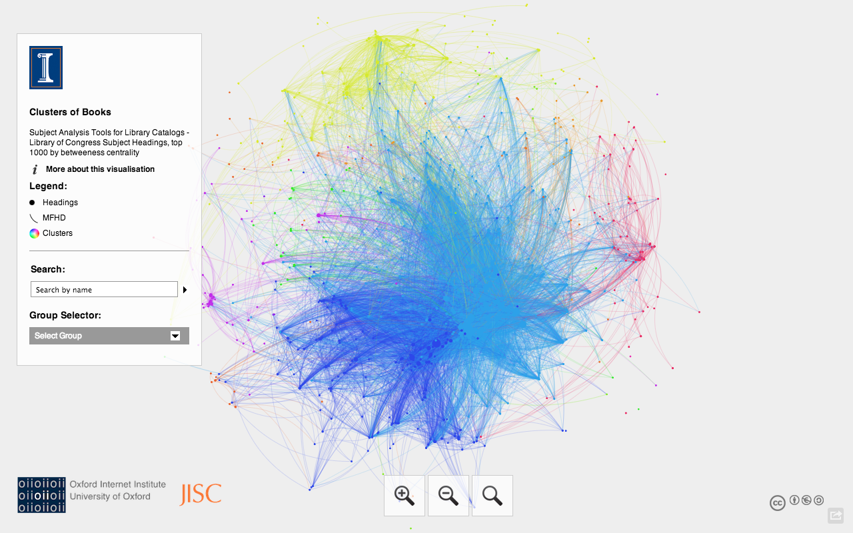
Sigma.js Demo
http://publish.illinois.edu/collectionsmining/

Slide 43
challenges
Outlier Clusters Analysis
Processing all items in catalog is computationally expensive (~150,000 SUs)
Need to connect our system to another more efficient method of analysis
OracleDB integration, Neo4j
Development of recommender tool / API

Slide 44

Next Steps….

Slide 45
Resources and Tools
Visualizing Data: http://www.visualisingdata.com
Flowing Data: http://flowingdata.com
Text Visualization Browser: http://textvis.lnu.se
Information is Beautiful: http://www.informationisbeautiful.net/visualizations
The Data Visualization Catalogue by Severino Ribecca, http://www.datavizcatalogue.com/index.html

Slide 46
Discussion Questions To Think About…
How can libraries provides tools and services to support data visualization?
How can libraries and archives model this type of research with their own data from collections, metadata, etc.?
How can we collaborate with other units on our campuses to support data visualization?
What can we do to reach out and engage scholars who are conducting research that uses data visualization?

Slide 47

QUESTIONS?
Harriett Green
University of Illinois at Urbana-Champaign
green19@Illinois.edu
Twitter: @greenharr

